Slide 1
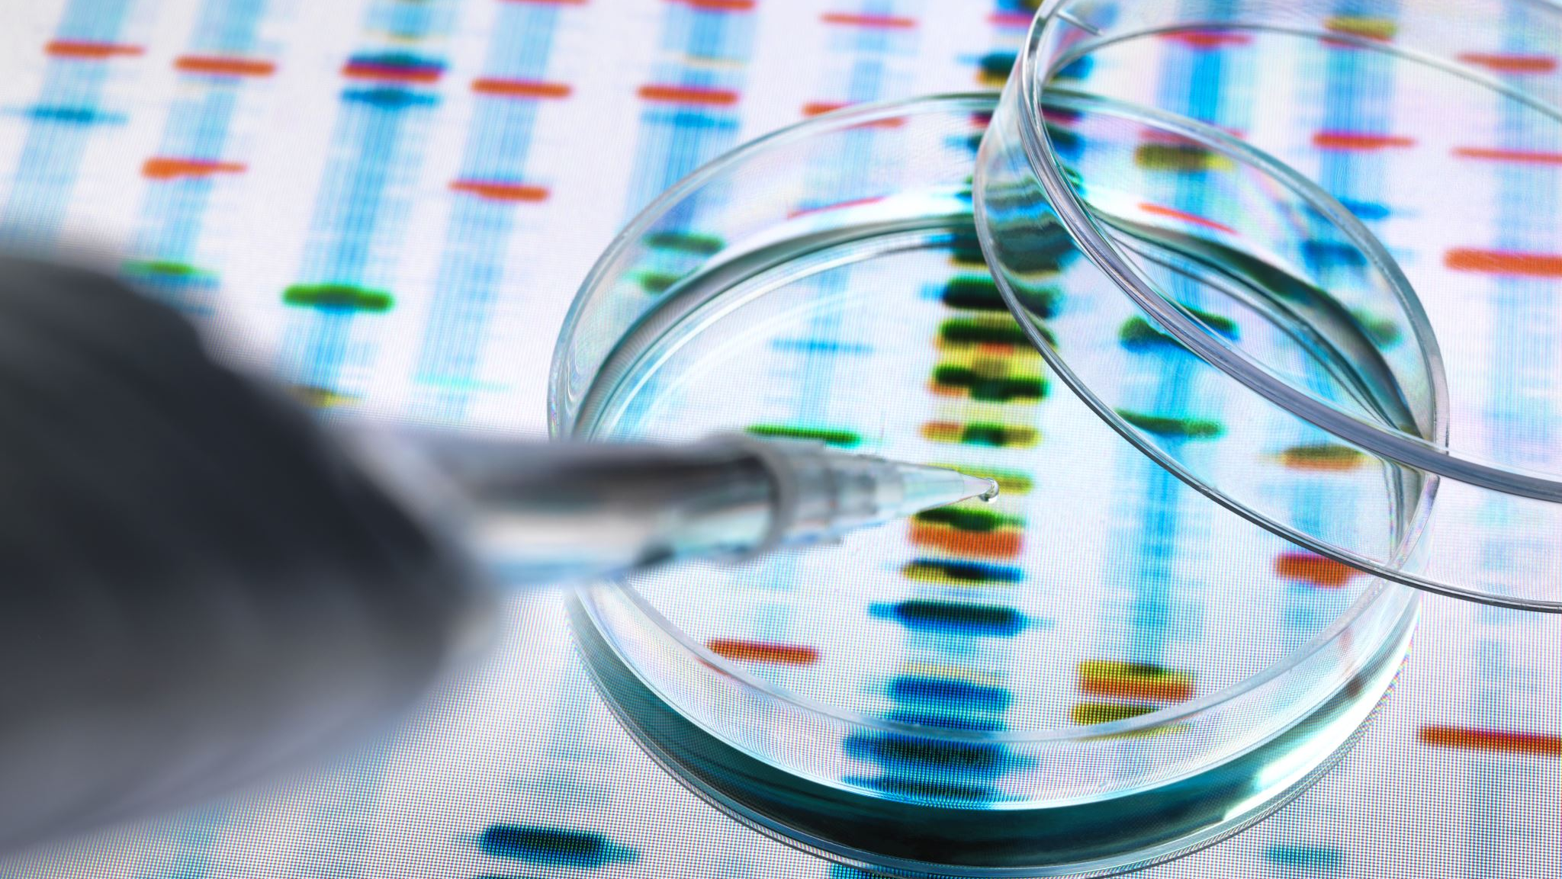
Analyzing Microbial Diversity in CRC Patients
Julie Fazekas

Slide 2
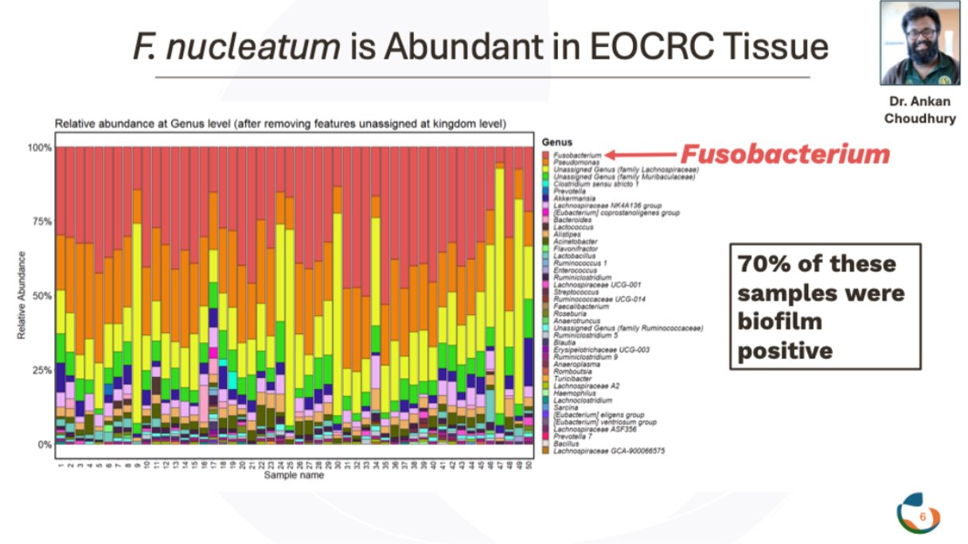
The Gut Microbiome & CRC

Slide 3
Objectives
Develop Shannon Diversity plot for microbial diversity at different CRC pathological stages
PCA plot to investigate microbiome diversity of individuals among CRC patients
Datasets used: The cancer microbiome atlas (TCMA): A pan-cancer comparative analysis to distinguish organ-associated microbiota from contaminants
Relative abundance
Patient metadata

Slide 4
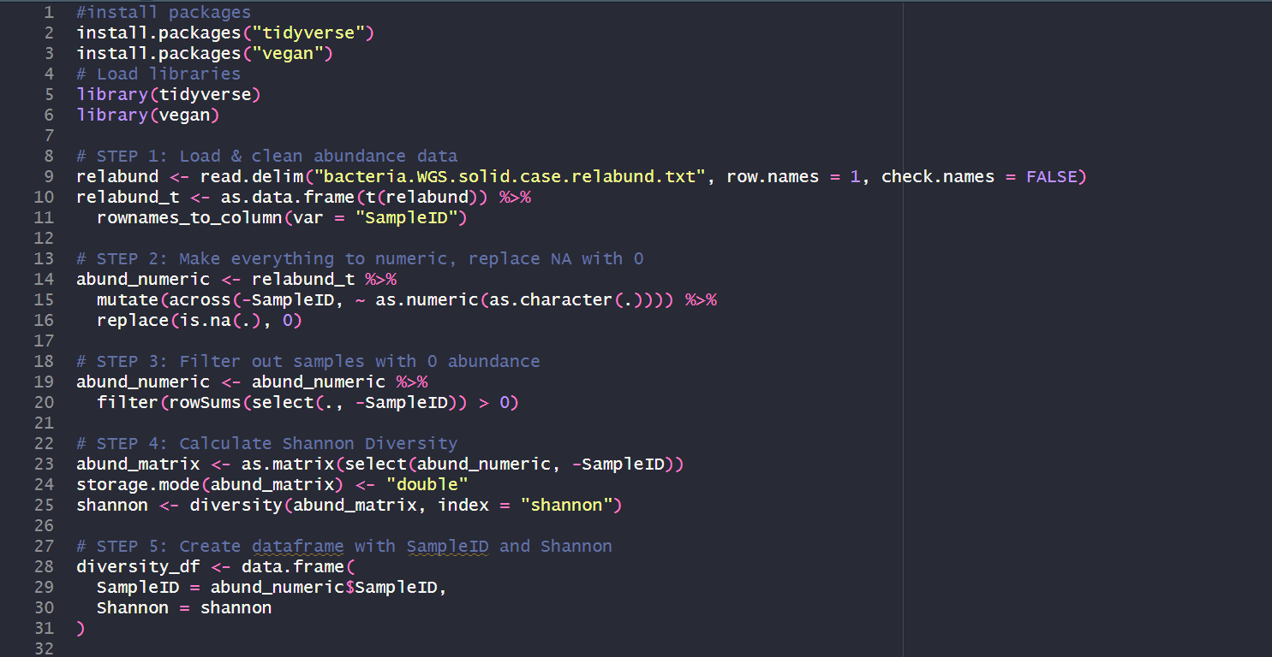

Slide 5
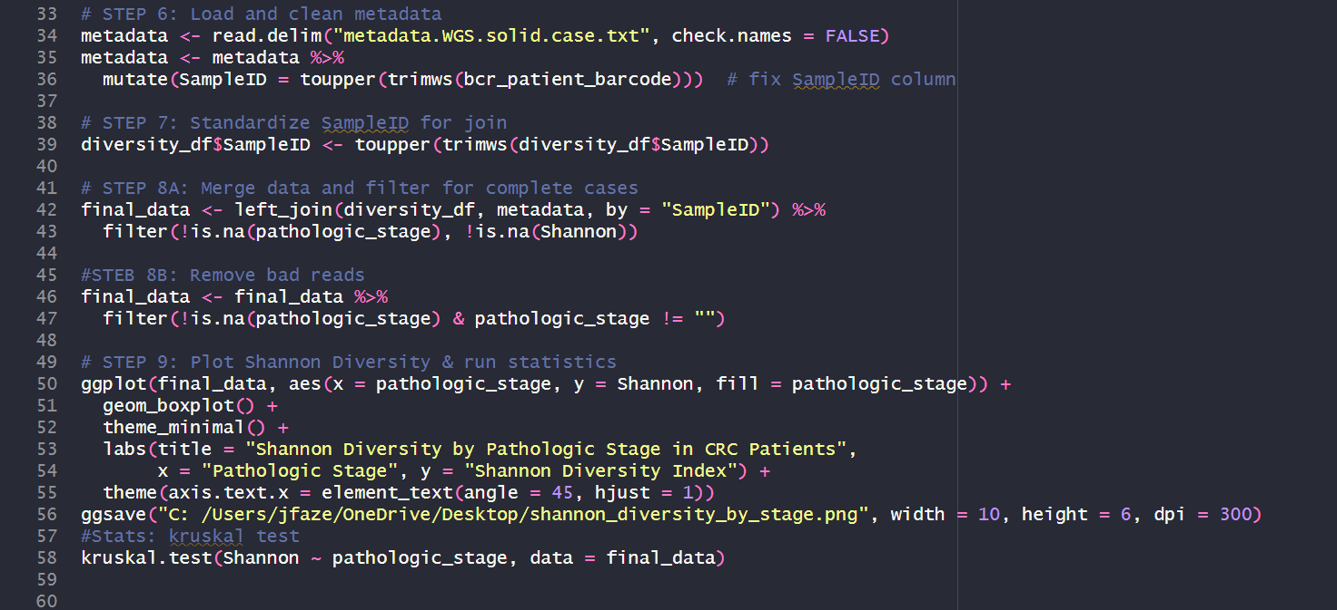

Slide 6
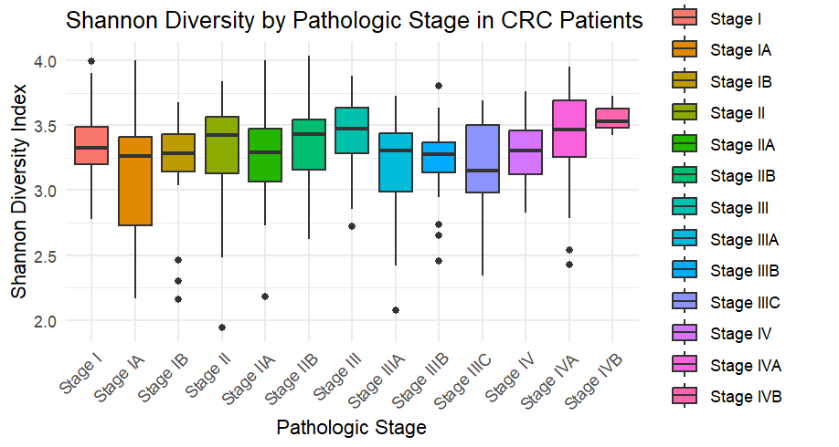

Slide 7
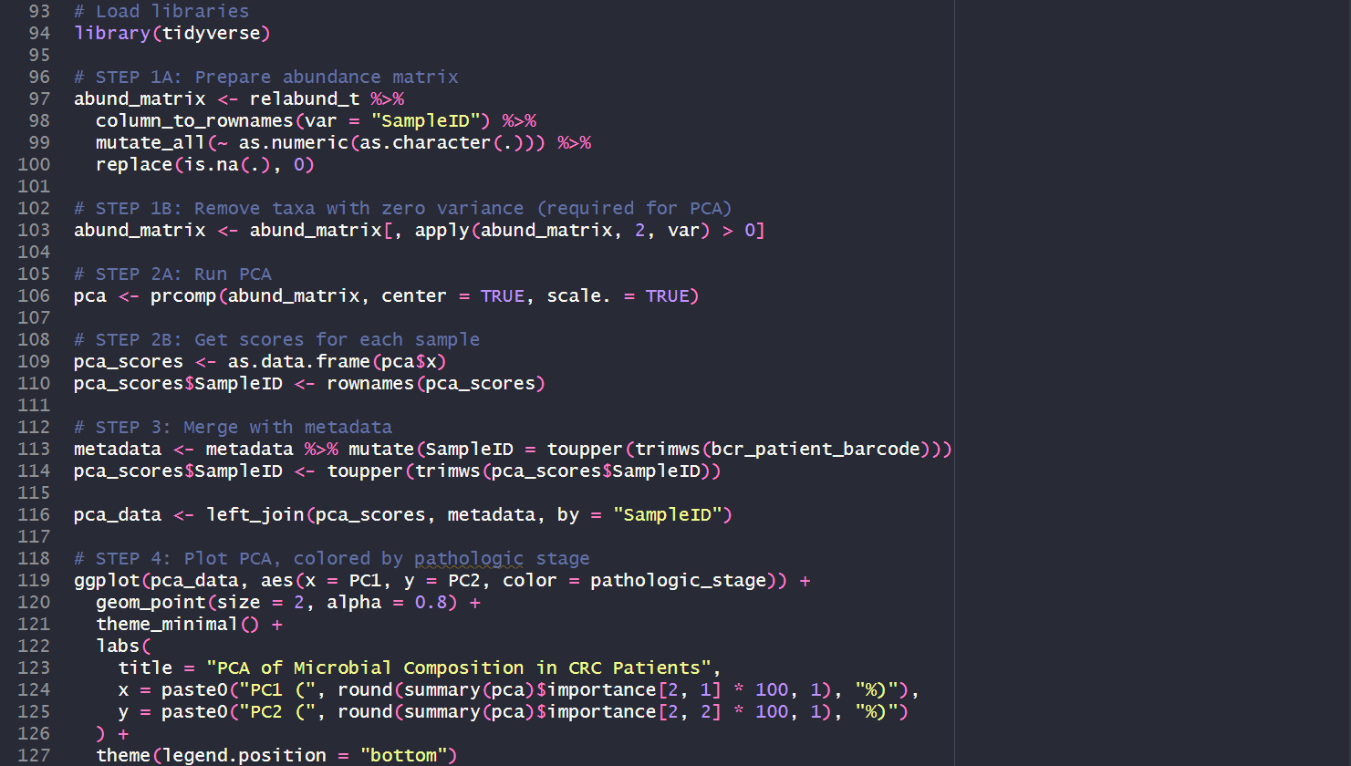

Slide 8
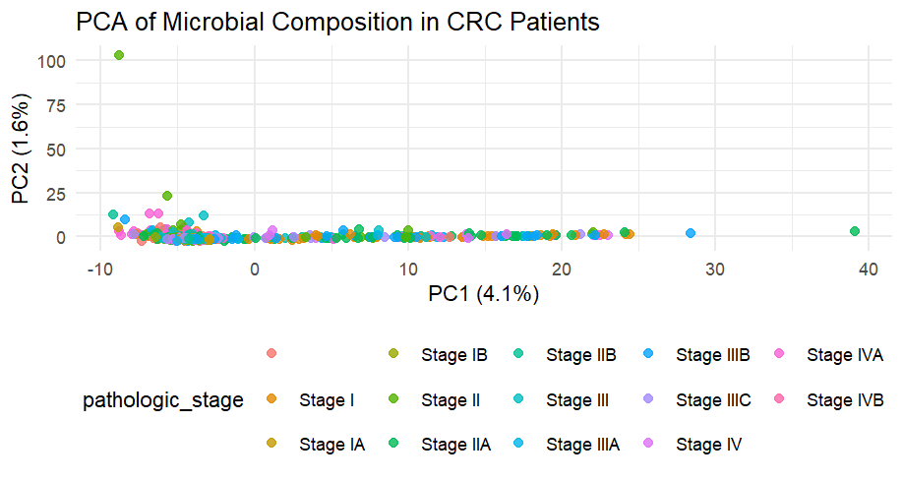

Slide 9
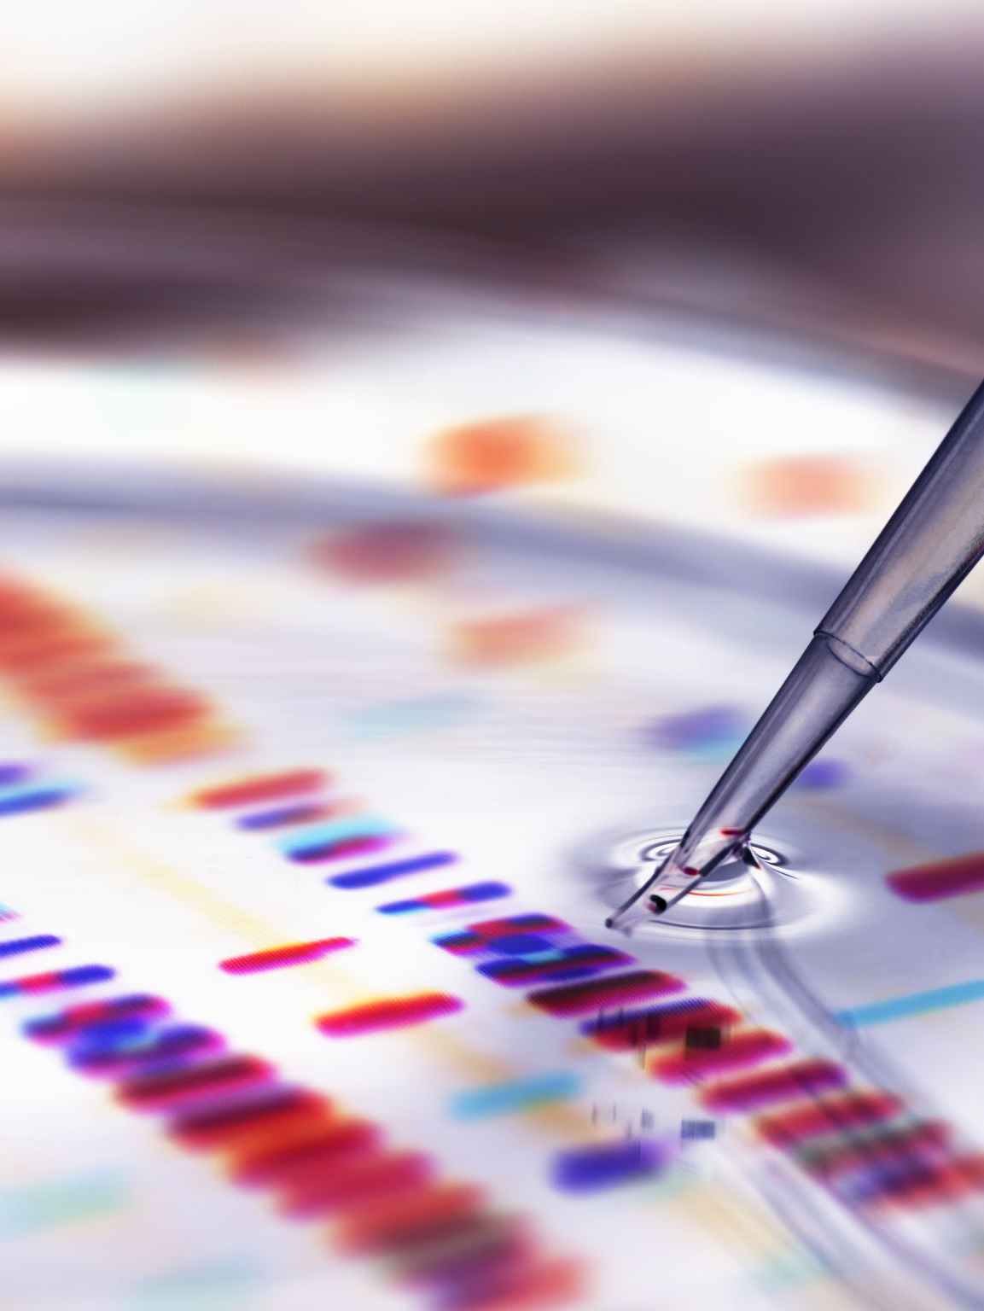
Conclusions
No clear trend for microbial diversity among individuals or CRC-stage
This code is useful for:
Looking at trends across groups & individuals
Not limited to cancer biology

Slide 10
References
Chodhury, A (unpublished)
Dohlman, A., Arguijo Mendoza, D., Ding, S., Gao, M., Dressman, H., Iliev, I., Lipkin, S., & Shen, X. (2020). Data from: The cancer microbiome atlas (TCMA): A pan-cancer comparative analysis to distinguish organ-associated microbiota from contaminants. Duke Research Data Repository. https://doi.org/10.7924/r4rn36833

Slide 11
Thank you
Questions?

